Slide 1

ProJect:
KidsGao(clone)

Slide 2
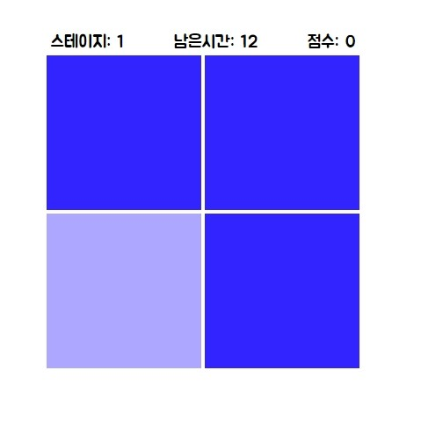
ProJect:
DiffColorCatch
(clone)

Slide 3



Slide 4





Slide 5


Slide 6




Slide 7



Slide 8



Slide 9

정보처리기사
컴퓨터활용능력 2급

